Slide 1

Hetergenous Wireless Networks

Slide 2
Table of contents
01
02
03
04
Abstract
Literature Survey
Simulation/Result
Conclusion

Slide 3
Abstract

Slide 4
Unified Connectivity: Exploring the World of Heterogeneous Wireless Networks
Hetergenous Wireless Networks refers to a network architecture that integrates different types of wireless networks, such as celluar networks, Wi-Fi, satellite communication, and Bluethooth, into a signle integrated system. This integration allows for more efficient use of resources, improved coverage, and enchanced connectivity speeds.
This integrated system enable devices to switch between different types of networks without any effort, ensuring that users always have the best possible connection based on their location a the network conditions. The concept of Hetergenous wireless networks also plays key role in development of next-generation wireless technologies(Such as 5G).

Slide 5
Literature Survey

Slide 6
This Literature Survey on heterogenous wireless networks explore various types, methods and mechanisms that enables these networks to provide seamless connectivity and efficient communication.
Types Of Networks in HWNs:
Cellular Networks - 4G, 5G, Wide-area coverage and high speed data services.
Wi-Fi Networks – Local area connectivity, High speed internet access.
Satellite Communication – Global Coverage, useful in remote areas (Ex: Starlink)

Slide 7
Methods For Integration in HWNs:
Single Attribute Based Mechanism: This Mechanism is a decision-making approach where decisions are made based on evaluating on single arrtibute such as, Signal strength, Bandwidth etc.
Multi Attribute Based Mechanism: Multi-attribute based decision making involves evaluating and comparing options based on several different attributes simultaneously. This approach depends on multiple factors, each contributing to the overall value.
Fuzzy Logic
Analytic Hierarchy Process (AHP)

Slide 8
Fuzzy Logic: Fuzzy Logic is a method that resembles human reasoning. It deals with reasoning that is approximate rather than fixed or exact. Unlike traditional Boolean logic where variables may only be 0 or 1 and True or False, Fuzzy logic variables may have a truth in handling between 0 and 1, representing the degree of truth.
Analytic Hierarchy Process (AHP): AHP is a structured technique for organizing and analyzing complex decision, based on ranking and psychology. It makes decision making easy as it breaks down a complex problem into hierarchy of simple sub-problems. AHP is very useful in planning, selection etc.

Slide 9
Mechanisms for Efficient Communication
Handover Mechanisms
Resource
Allocation
Load
Balancing
Enable Devices to seamlessly switch between different network types
Dynamically allocate network resources to meet the user demands.
Distributes network traffic evenly across all network types to prevent overloading.
Quality of
Service (Qos)
Energy Efficiency Management
Security
Protocols
Prioritizes network traffic to ensure important applications receive the bandwidth and speed for optimal performance
Reducing the power consumption of network devices and operations while maintaining performance and service quality
Addressing the divesre security challenges of integrating multiple networks types, data integrity etc.

Slide 10
Simulation

Slide 11
Simulation 1

Slide 12
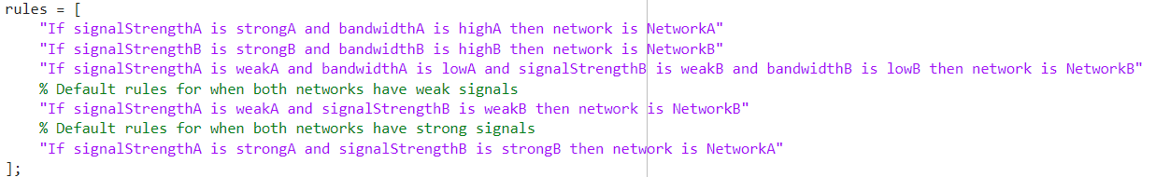
HWNs Network Selection Using Fuzzy Logic
To Simulate the Network Selection between two Heterogenous wireless Networks we have used “MATLAB”
Pre-Set Fuzzy Logic rules in the Matlab simulation code:

Slide 13
HWNs Network Selection Using Fuzzy Logic
Membership Functions of Fuzzy interface system (FIS):
For Signal Strength:
Weak (weakA, weakB) – 0 to 70, with full weak from 0 to 30
Strong (strongA, strongB) – 30 to 100, with full strong from 70 to 100
For Bandwidth:
Low (lowA, lowB) – 0 to 80, with full low from 0 to 20
High (HighA, HighB) – 20 to 100, with full high from 80 to 100

Slide 14
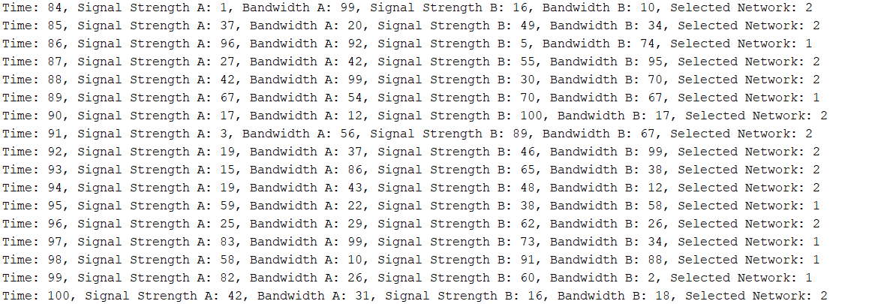
HWNs Network Selection Using Fuzzy Logic
Result:
Total 100 iteration, in each iteration there are two networks and one network is selected based on Fuzzy logic pre-set rules as shown above.

Slide 15
Simulation 2

Slide 16
HWNs Network Selection Using Fuzzy Logic
Input Variables:
delay: Represents delay in network transmission.
jitter: Indicates the variation in packet delay.
packLoss: Reflects the percentage of lost packets.
monetary: Represents the cost factor associated with the network.
Output Variable:
QI (Quality Index): Indicates the quality level of a given network (1-5)
Fuzzy Inference System (FIS):
Utilizes membership functions to fuzzify inputs (delay, jitter, packLoss, monetary) and outputs (QI).
Rules are defined to map specific input conditions to QI values.

Slide 17
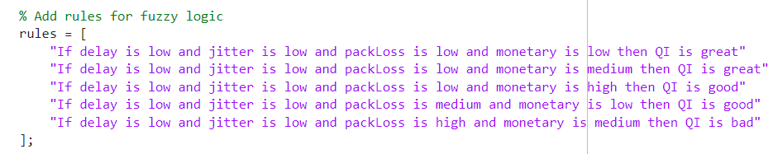
HWNs Network Selection Using Fuzzy Logic
Rule base:

Slide 18
HWNs Network Selection Using Fuzzy Logic
Simulation:
Random network conditions (delay, jitter, packLoss, monetary) are generated.
Fuzzy logic is applied to evaluate the network quality (QI) for each of the four network options.
The network with the highest QI value is selected.
Plots the selected network over time.

Slide 19
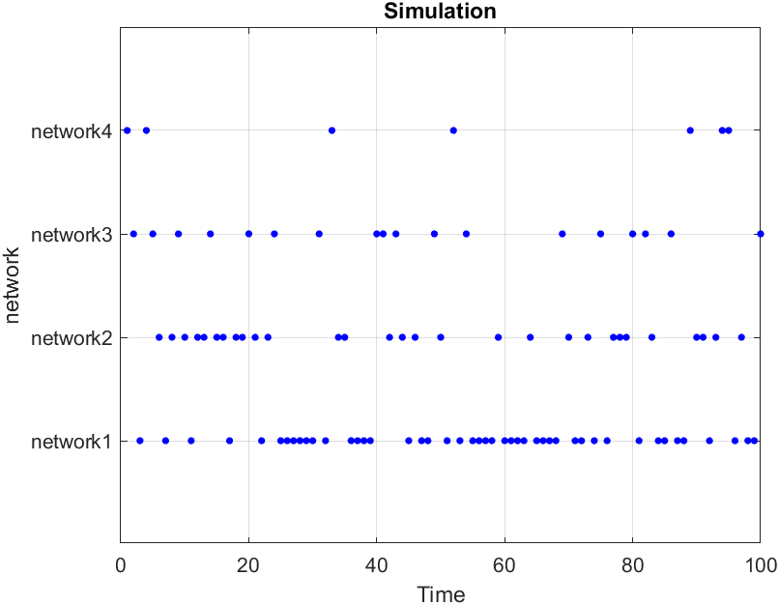
HWNs Network Selection Using Fuzzy Logic
Result:

Slide 20
Conclusion

Slide 21
Summary
Discussed what is Fuzzy logic
Took a look at what is heterogenous networking
Discussed what is handover
Discussed what are all the problems with handover
Discussed the parameters of selecting the network
Discussed the algorithms we proposed

Slide 22
Thank You!!

